Slide 1
Senior project final presentation – vip 3.0
Team Members: Daniel Lopez, Vladan Lalovic, Michael Martinez, and Johnathen Jenson
Product Owner: Mohsen Taheri
Instructor: Masoud Sadjadi

Slide 2
PROBLEM
Before VIP, faculty and head of research projects had to spread information to students by word of mouth. Students had to physically talk to a professor to find about research projects that they were interesting to join.
There wasn’t a system to allow people to apply and be vetted before joining.
Then came VIP based on Georgia Tech’s VIP which stands for Vertically Integrated Projects.
VIP is a website that acts as a social platform that allows faculty and students to collaborate in research projects. They can communicate and they have access to source control, and etc.

Slide 3
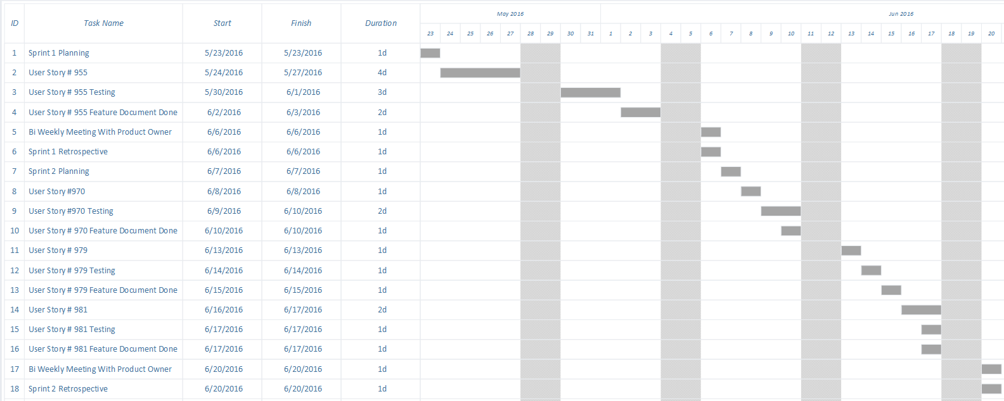
Gantt chart (full schedule)

Slide 4
Requirements
The system allows for users, depending which role the user has, to be able:
Register Login/Logout
Team Page
Profile With Resume
Apply for Projects
Review Project
Student Applications
Propose Project
To-Do Notifications
Messaging System
Admin Panel

Slide 5
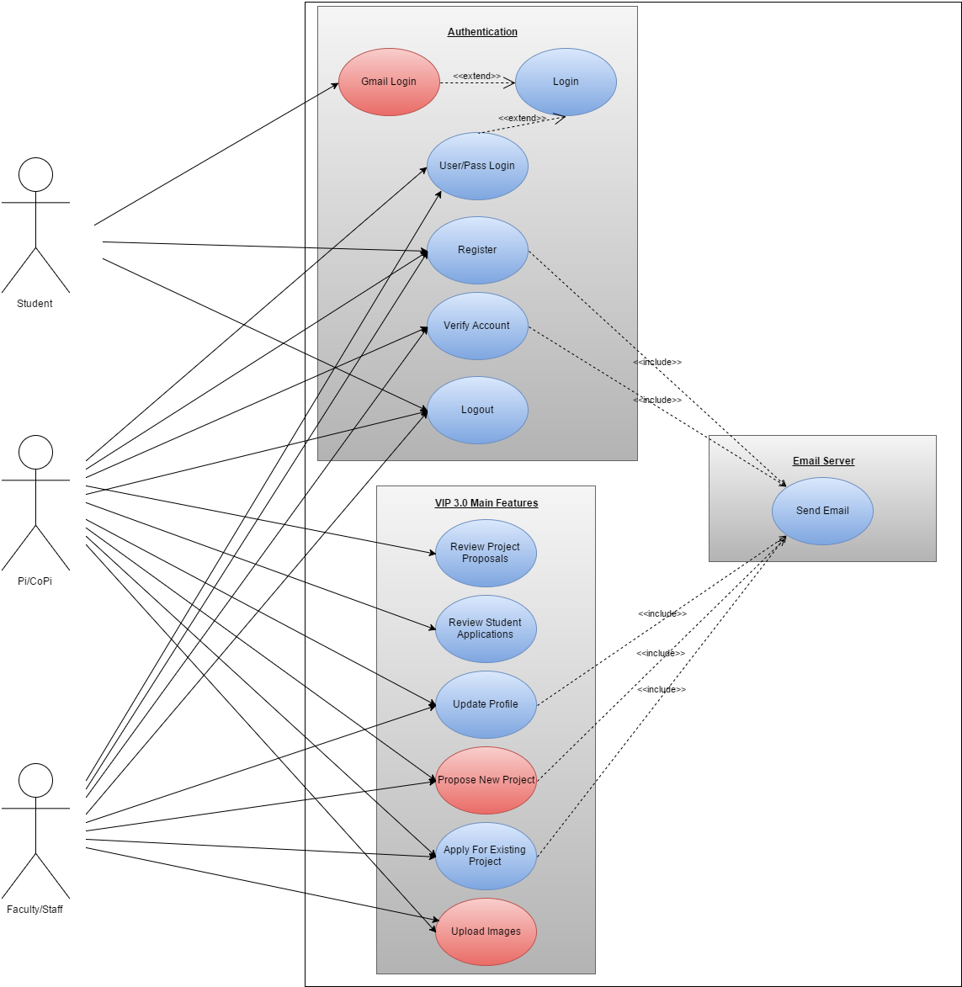
USE Case Diagram (system)

Slide 6
Use Case (LOGIN)
Participating Actors: User Entry Condition: Visit Login Page Must Be Not Logged In Events Flow:
Enter username.
Enter password.
Click login.
Redirected to home page or the last page that required login access.

Slide 7
Use Case (Logout)
Participating Actors: Pi/CoPi,Faculty,Student Entry Condition: Must be Logged In Events Flow:
Click logout.

Slide 8
Use Case (Team’s page)
Participating Actors: User Entry Condition: Click on Teams. Events Flow:
Active Projects Loaded.
Active Projects Displayed.
Team Members and Owner Are Shown For Each Project

Slide 9
Use Case (Profile page)
Participating Actors: Signed In User Entry Condition: Must Be In Profile Page. Events Flow:
User Information Displayed.
Can Be Edited.
Can Upload Resume
Can View Current Resume and Profile Picture
Can Update Profile

Slide 10
Use Case (Apply for projects)
Participating Actors: Faculty, Pi/CoPi Entry Condition: Click on Apply Project. Events Flow:
Select Project
Click Apply
Receive Email

Slide 11
Use Case (Review project)
Participating Actors: Pi/CoPi Entry Condition: Must Be In Review Project Page. Events Flow:
Find Pending Project That You Want To Review
Click Accept To Accept Or Reject To Disapprove Of Proposal Idea
Email Gets Sent To Proposer Of Project Of Outcome

Slide 12
Use Case (review Student application)
Participating Actors: Pi/CoPi Entry Condition: Must Be In Review Student Application Page. Events Flow:
Find Student You Want To Review
Click Reject Student or Accept Student
Email Gets Sent To Student Of Outcome Of Whether He Can Be Part Of Project

Slide 13
Use Case (review Student application)
Participating Actors: Pi/CoPi Entry Condition: Must Be In Review Student Application Page. Events Flow:
Find Student You Want To Review
Click Reject Student or Accept Student
Email Gets Sent To Student Of Outcome Of Whether He Can Be Part Of Project

Slide 14
Use Case (Propose Project)
Participating Actors: Pi/CoPi, Faculty Entry Condition: Must Be In Propose Project Page. Events Flow:
Add Title
Add Description
Fill Optional Information
Click Submit
Receive Email Showing Project Pending Status

Slide 15
Use Case ( Todo nOTIFICATIONS)
Participating Actors: User
Entry Condition: Click To-Do Notifications Link
Events Flow:
Load To-Do.
Display To-Do Based On Which User.
Read,Click, or Delete Todo.

Slide 16
Use Case ( messaging)
Actor: Pi/CoPi/Project Owners/Students
Pre-conditions:
VIP Server is running.
User has navigated to the VIP website and successfully logged in.
Description:
Use case begins when the User navigates to the teams page (vip-projects).
User clicks on an active project, which will show the project details and the project members.
User clicks on the “message icon” next to the name of the user they wish to message.
User is navigated to the “messaging page”, fills in the “Subject” and “Body” of the message, and presses the “Submit” button.
User checks his/her “To-do notifications” and email for confirmation that the message has been sent.

Slide 17
Use Case ( ADMIN PANEL)
Participating Actors: Pi/CoPi Entry Condition: Must Be In Admin Panel. Events Flow:
Can Approve User
Can Remove User From Project
Can Move User To Project
Can Delete User
Can Message User

Slide 18
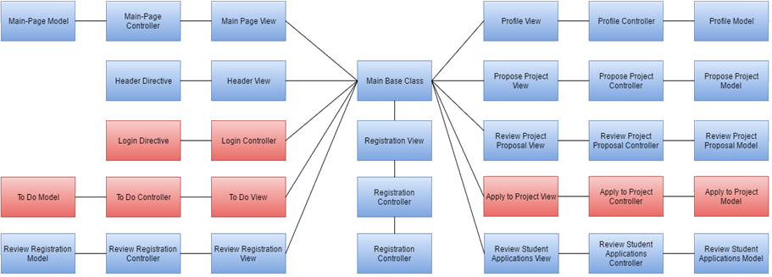
Class diagram (universal)

Slide 19
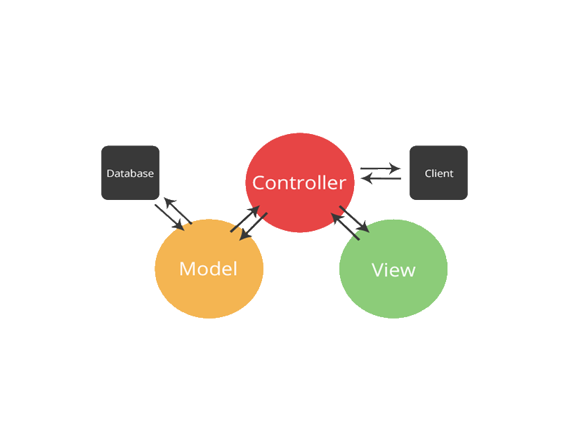

SYSTEM DESIGN: architecture
VIP incorporates a three-tier client server. HTTP and TCP/IP are the protocols that users communicate to the VIP website.

Slide 20

Security and privacy
OAuth Authentication (Google)
Password Hashing Plus Salt

Slide 21

DEMO
Now for a quick demo please view other videos for a through demo of specific features.

